Slide 1

InnovAct 2025
Track: IoT (Internet of Things)
Problem Statement Title: Smart Home Automation
Innovation ID: IR2025-995931
Team Name & Members:
Nazeer Ahammed S (23BEC0205)
Vignan B (23BEC0296)
P Harsha Vardhan (23BEC0311)
Shaik Shavez (23BEC0394)
Anushka Garg (24BEC0602)

Slide 2
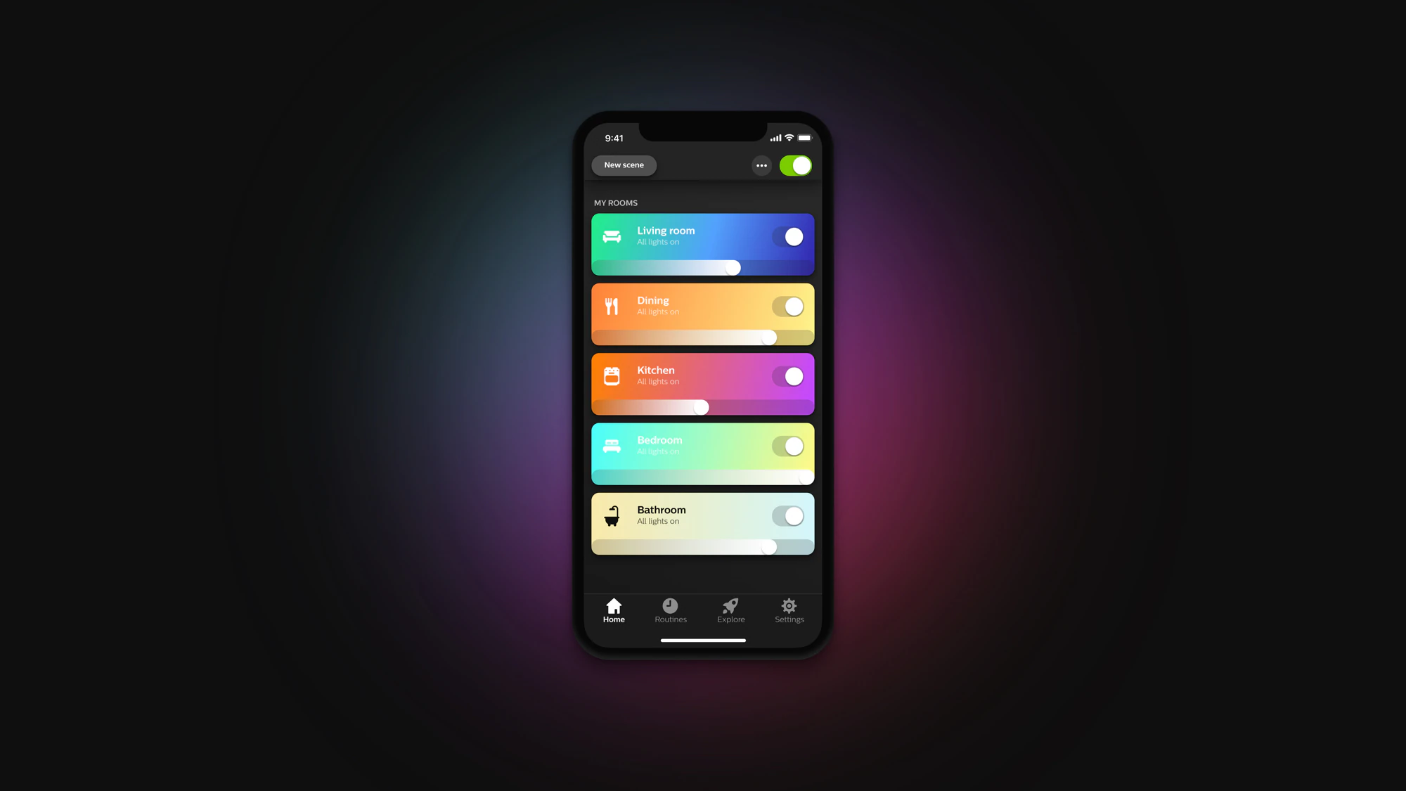
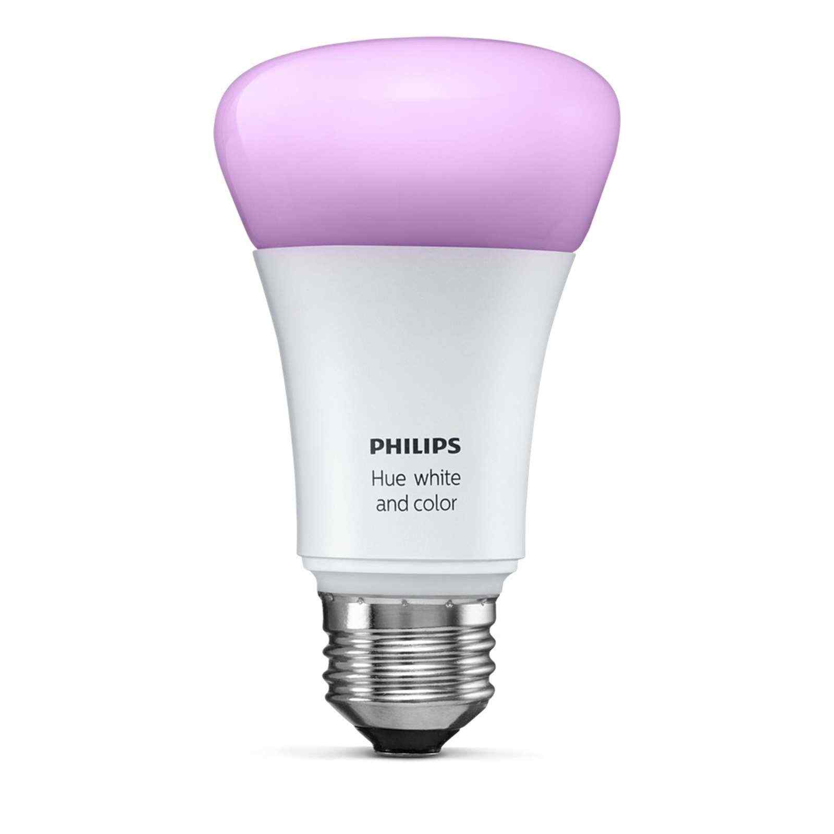




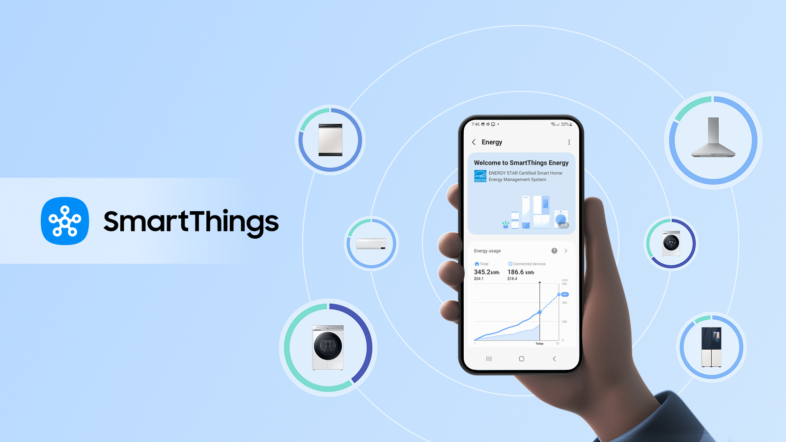
Problem Statement
Fragmented ecosystems → Philips Hue, Tuya, Modbus, Zigbee… don’t talk to each other.
cv
Vendor lock-in → forced to use one app/brand, subscriptions, cloud.

Slide 3
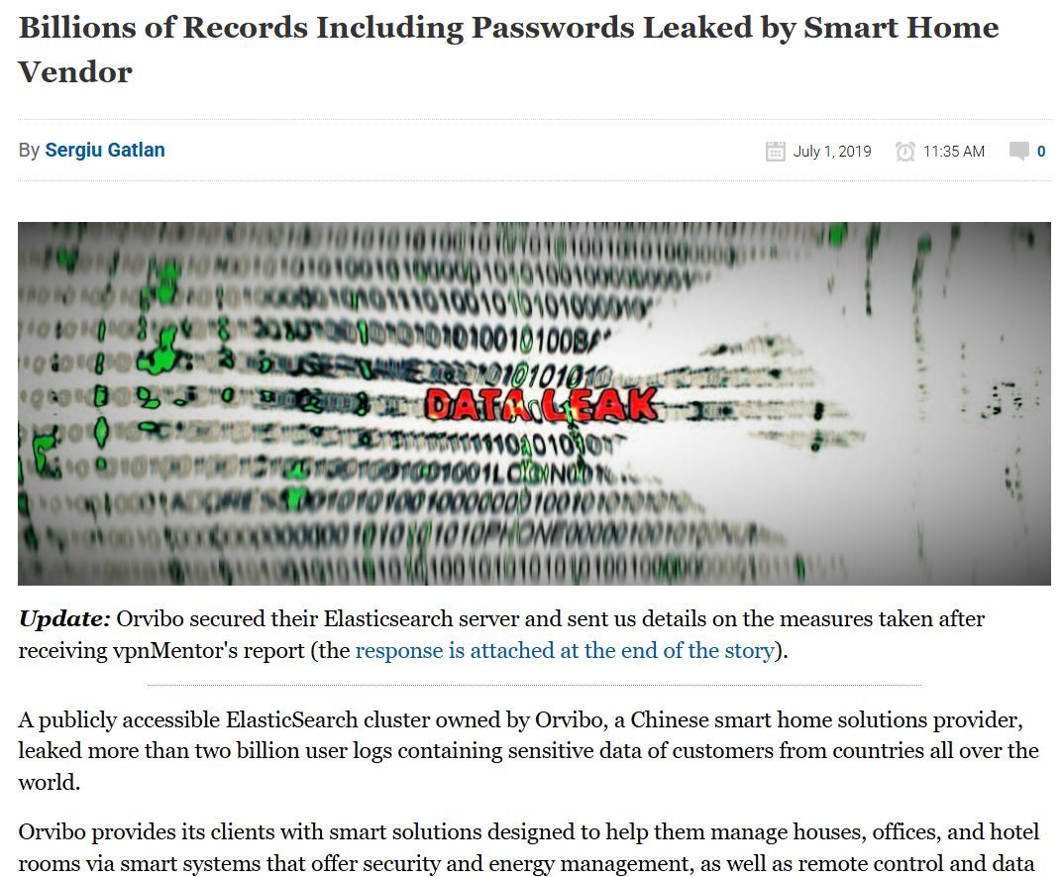
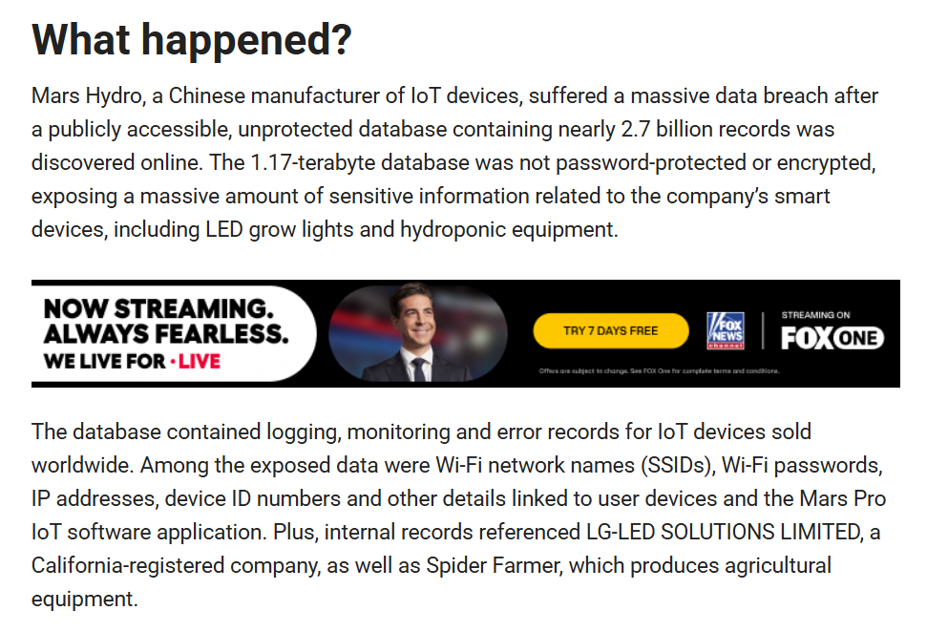
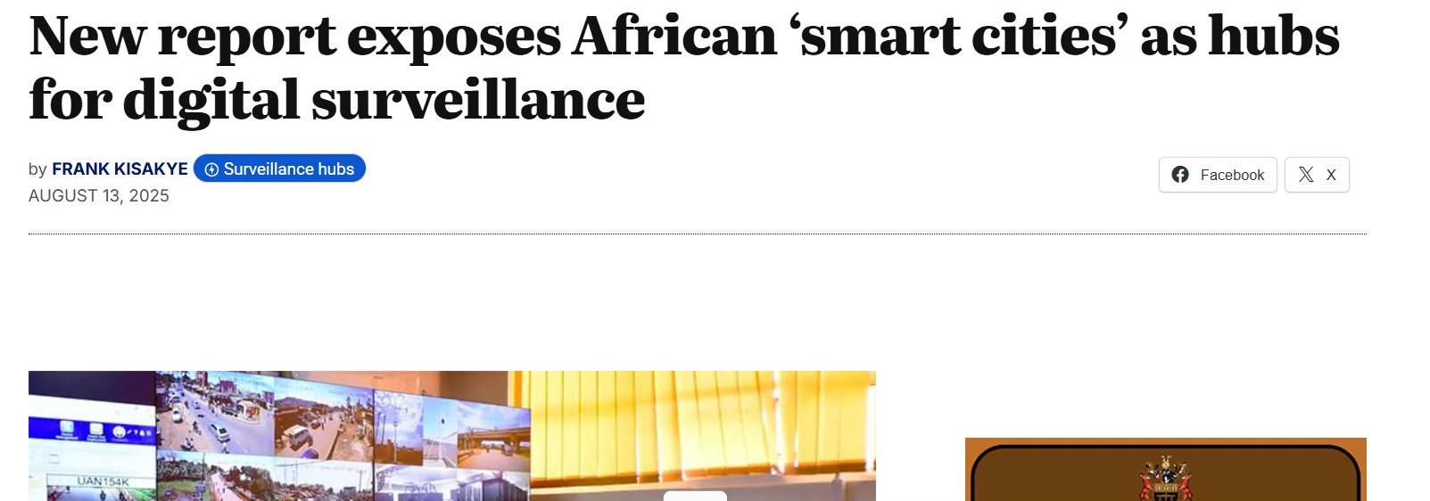
Privacy risk → data leaves your home. (Cloud connected)

Slide 4


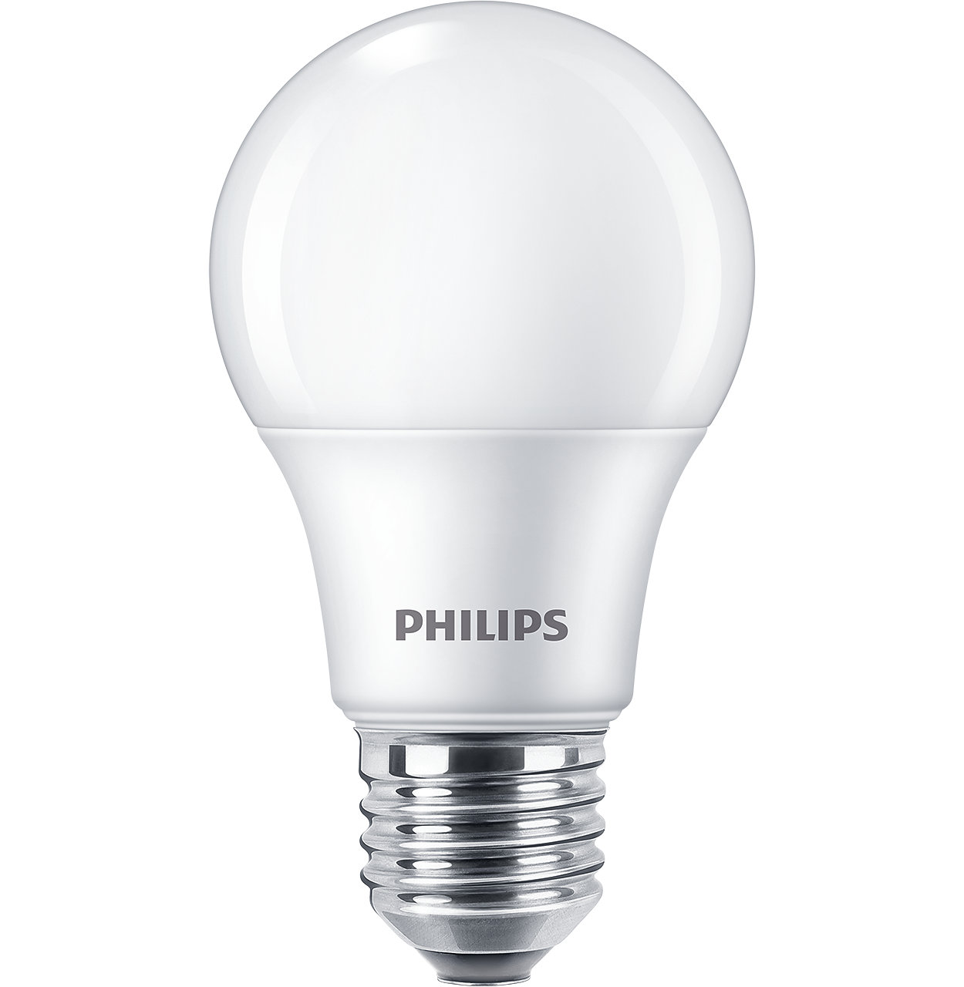
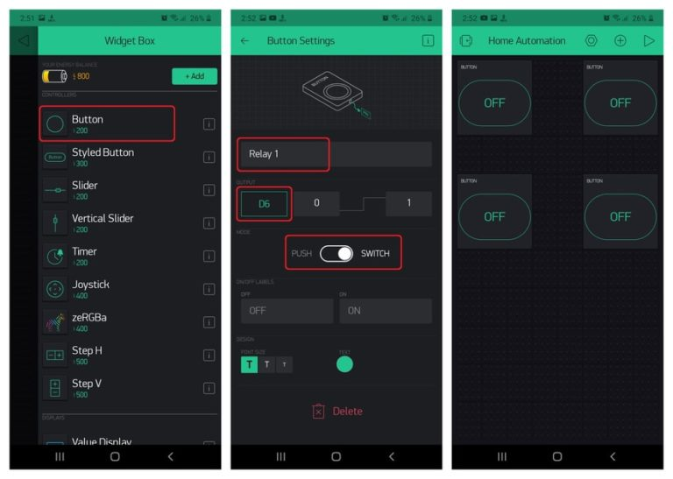
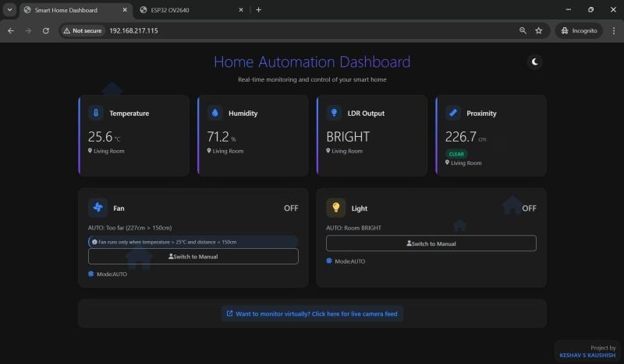
Short device lifespans → closed vendor apps die, devices become e-waste.
Existing student projects → usually just ESP webpage → not scalable, not user-friendly.

Slide 5
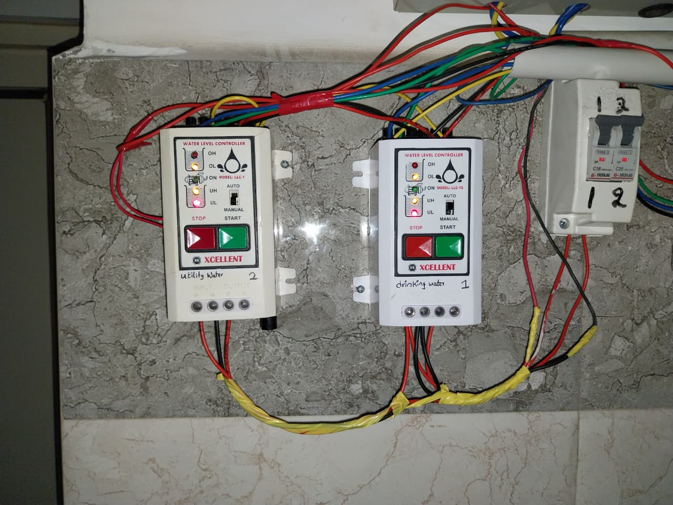
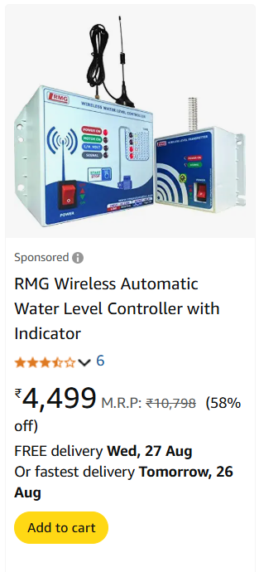
Personal Experience
1. Overhead Tank/ Sump Tank Level Controller
On the market motor pump controllers with no dry run protection and smart home feature

Slide 6
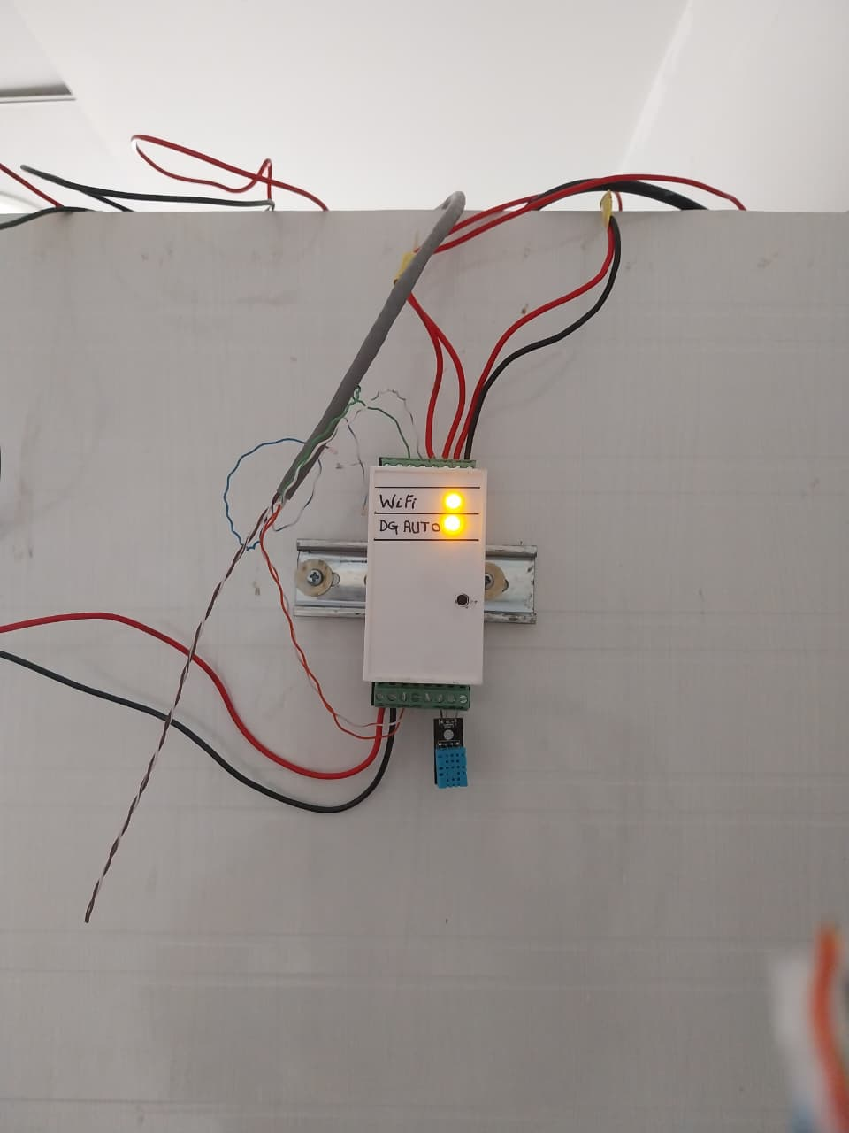
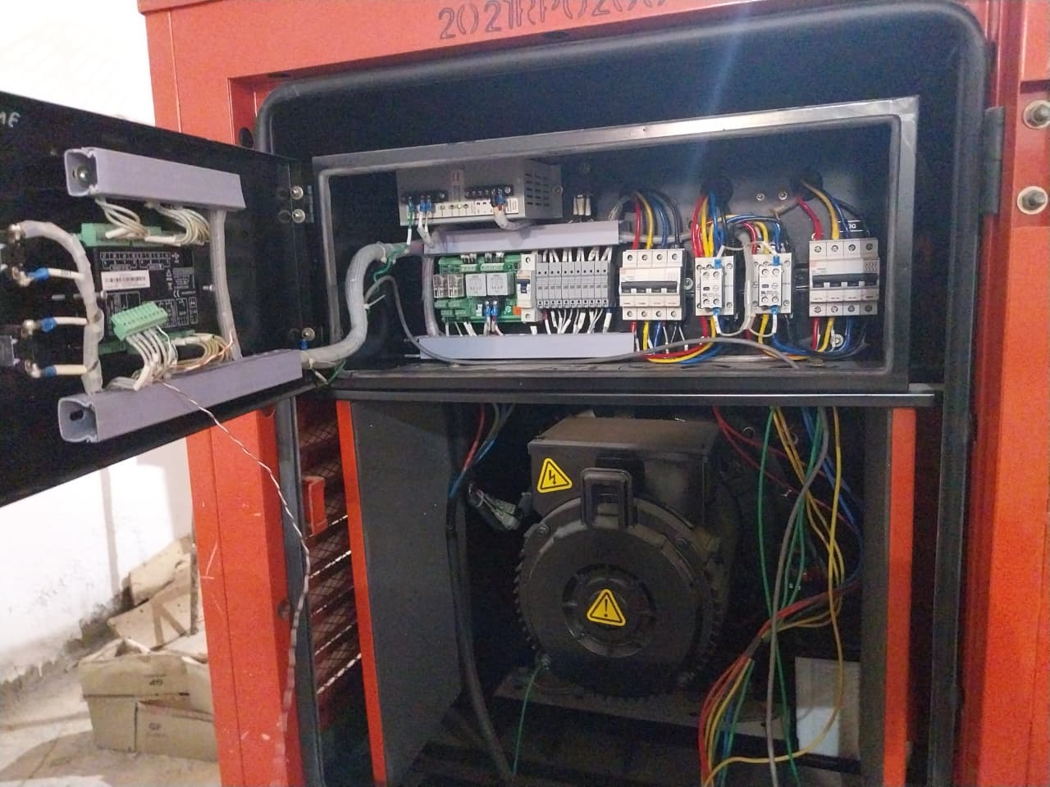
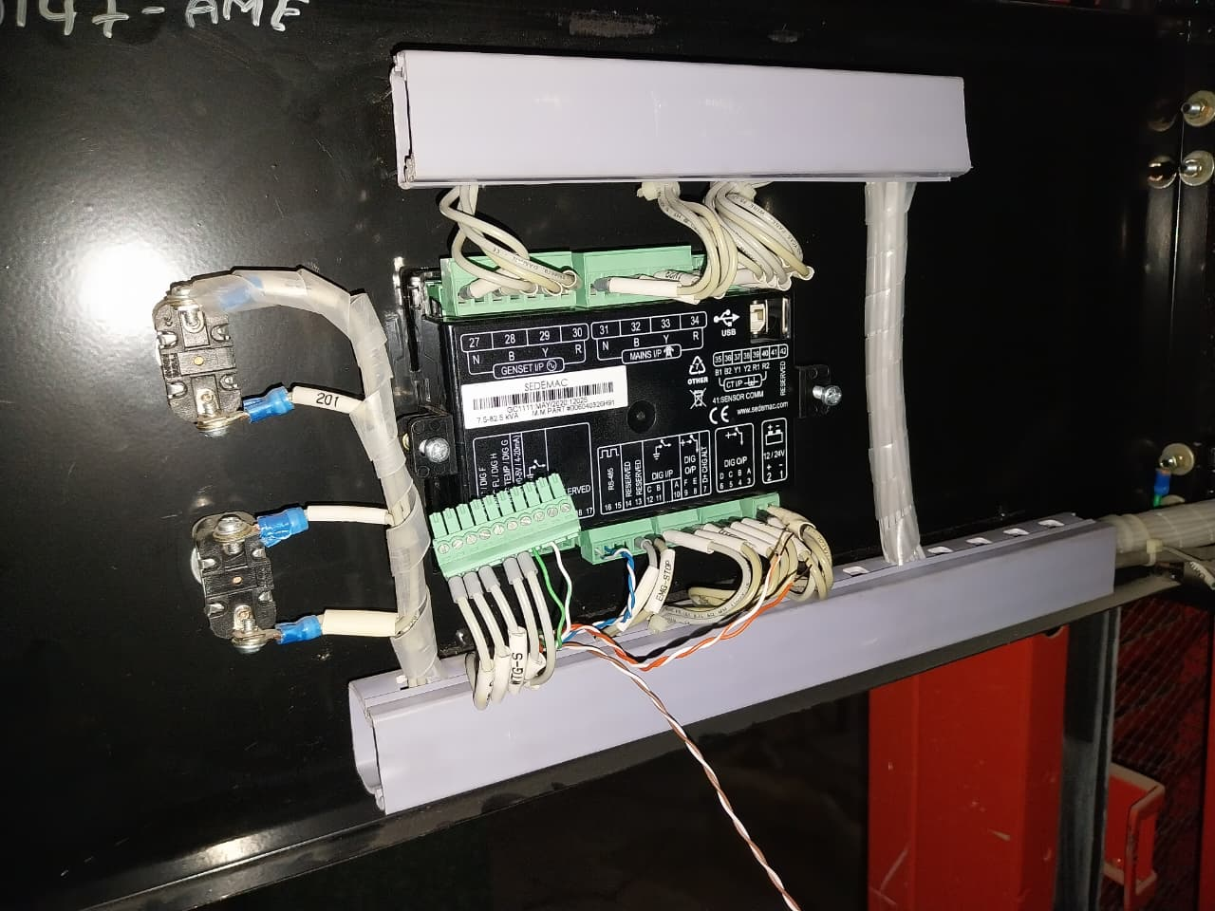
2. Diesel GenSet Automation

Slide 7
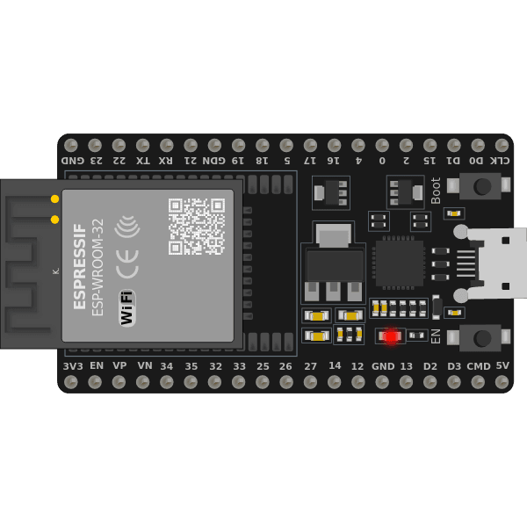
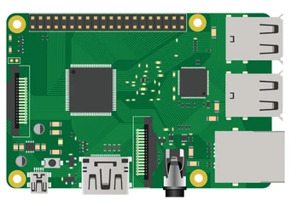
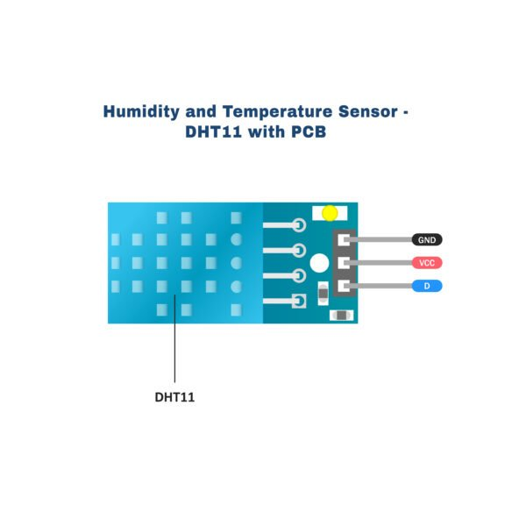

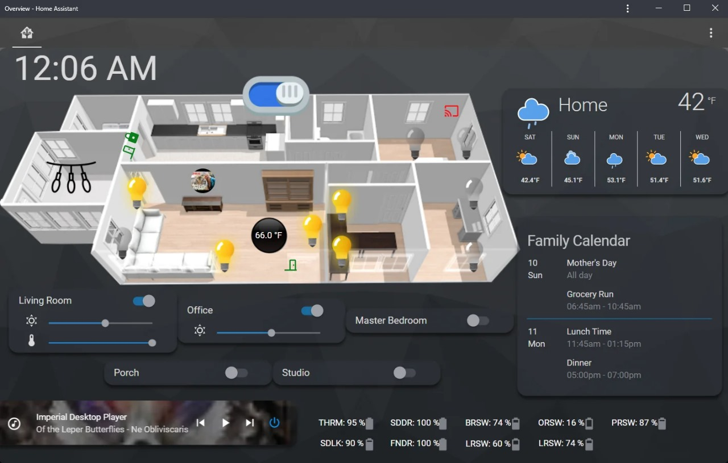
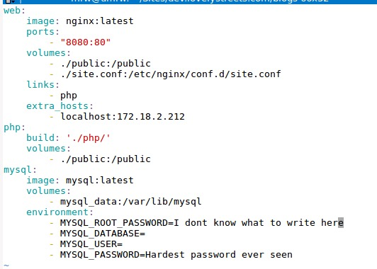
Proposed Solution
Local-Hosted Smart Hub/Server running on Raspberry Pi 4B, fully open-source.
Vendor-independent, plug-and-play for normal users, hackable for hobbyists.

Slide 8









Docker → modular + resilient
Isolation
Home Assistant
ESP Home
No Dependencies
Motion Eye OS
Integration of multiple devices & protocols (Wi-Fi ESP, Modbus DG sets, sensors).

Slide 9





Enable remote access via Zero-Tier/TailScale.
Firewall
Zero-Tier

Slide 10





Technical Approach
Software:
Docker (Containers)
Home Assistant (UI + automations)
ESPHome (ESP configs)
MotionEye (cameras)
Zero-tier (remote access)
Portainer (Status of Containers)
Glances (Health of Server)

Slide 11
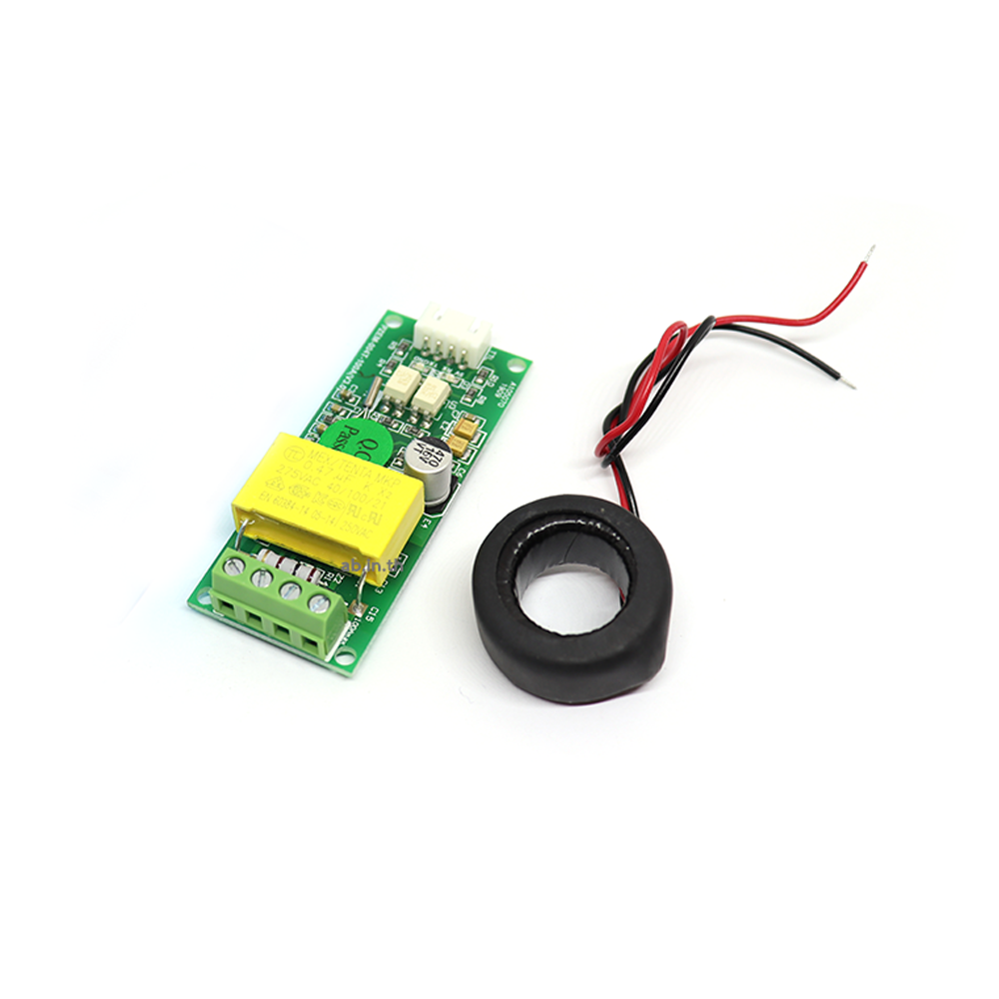


Hardware:
Node
Server
Works as standalone unit
LED’s
PZEM-004T
Custom Water Level Float
DHT 11
USB Webcam

Slide 12
Demo / Prototype
Working prototype includes:
Real-time monitoring of temperature, humidity, energy usage.
Camera surveillance via MotionEyeOS.
Remote appliance control (lights, switches).

Slide 13
Impact & Use Cases
Homes: Lights, water tanks, energy monitoring.
Schools: Lab safety (temp/leak alerts), energy dashboards for awareness.
Colleges/Hostels: Tank automation, common resource monitoring.
Apartments/Gated communities: Pumps, lighting, visitor cameras.
Small industries: DG set monitoring, Modbus devices, energy dashboards.
Sustainability: Reuse old devices (ESP plugs, phones as cameras), reduce e-waste.

Slide 14
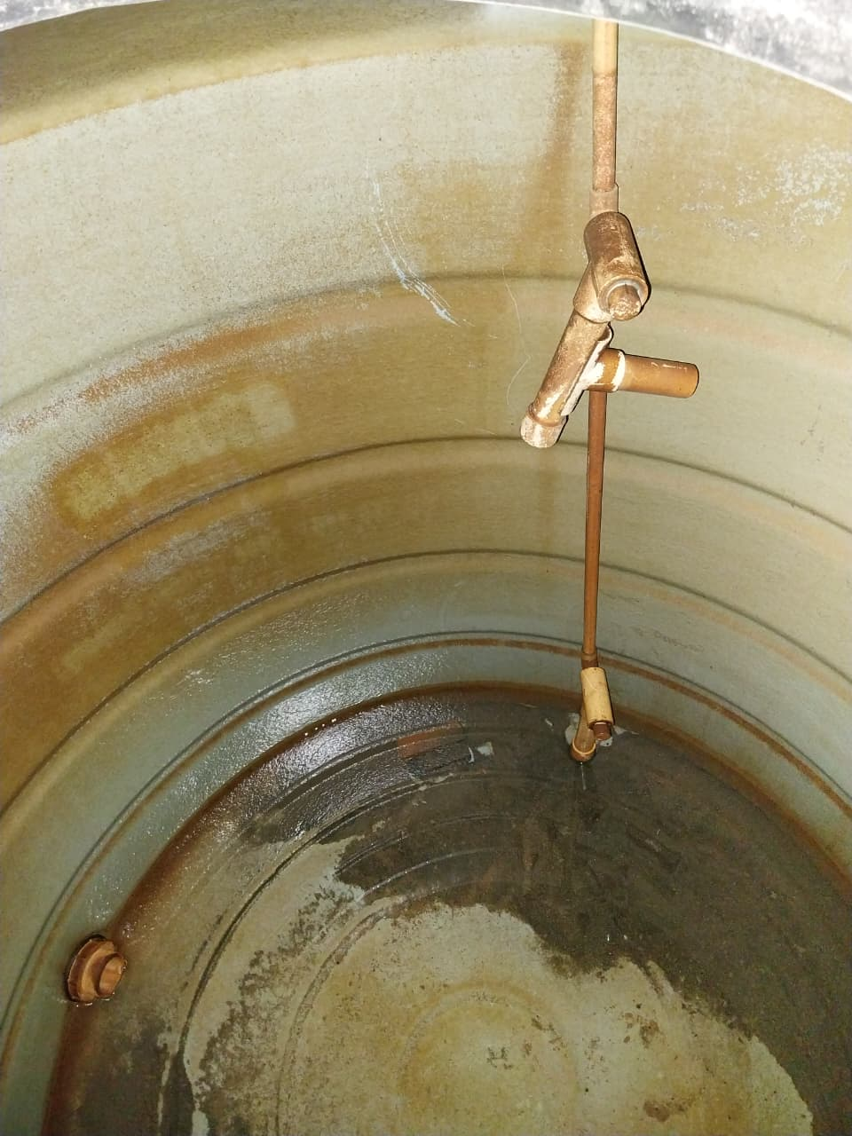
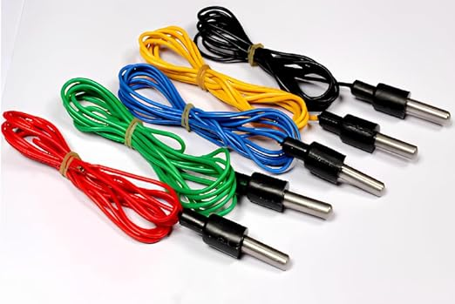
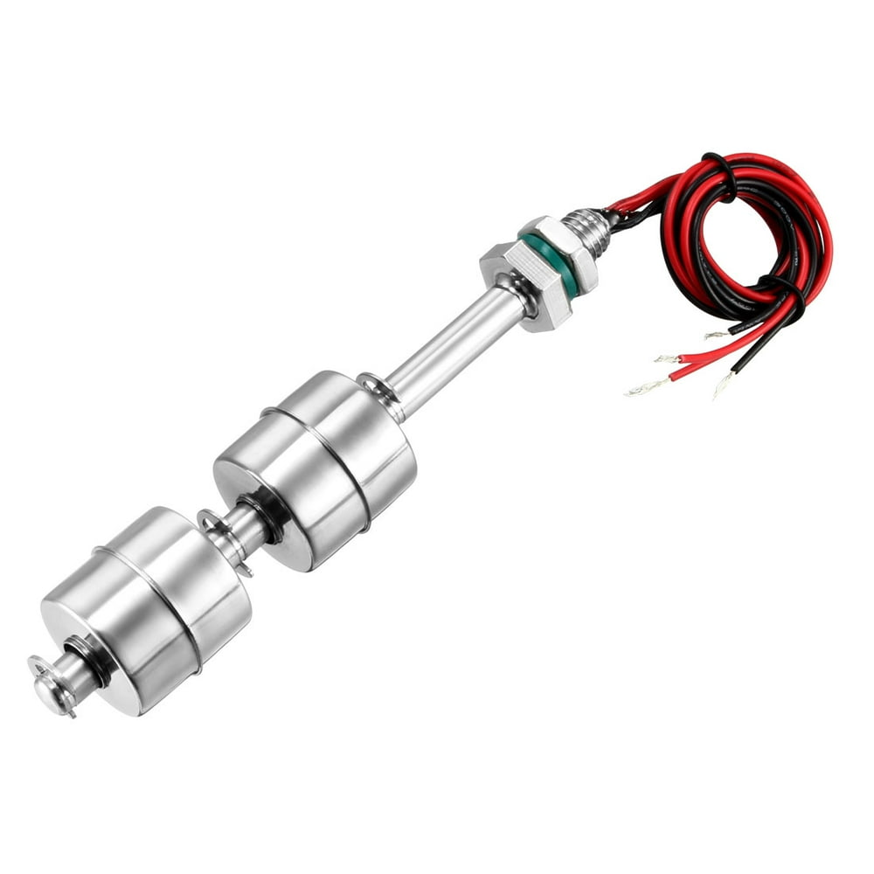
Level Sensors
My Implementation

Slide 15


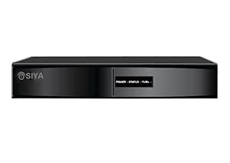

3. Improvement of CCTV Storage systems
Traditional Setup: Surveillance CCTV Systems
Network Video Recorder
Gigabit Switch
Monitor

Slide 16

ONVIF Protocol
Improvised Setup
Monitor
Gigabit Switch
Server
Smart Phone
Can handle many services at once

Slide 17

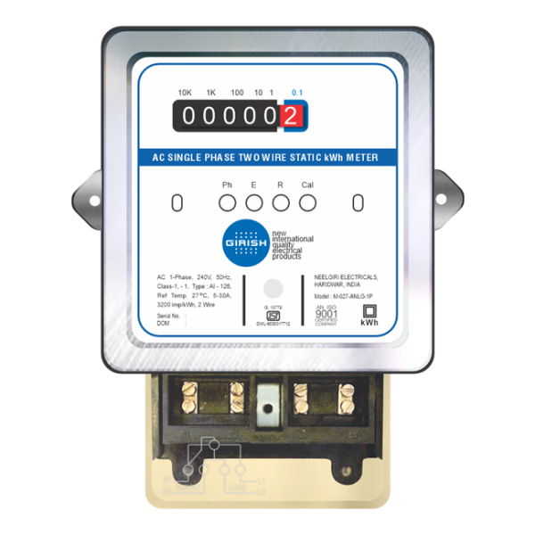
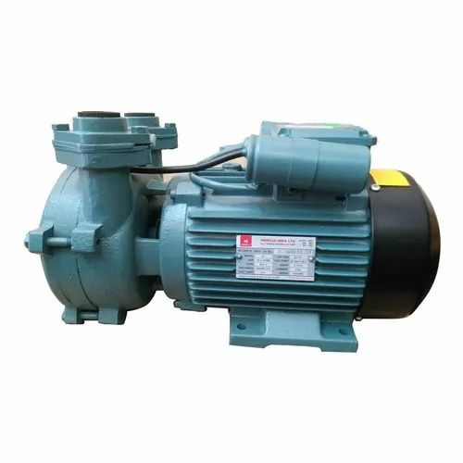
3. Apartments/Gated Communities
Tank-1
Tank-2
Tank-3
Node - 1
Node - 2
Node - 3

Slide 18
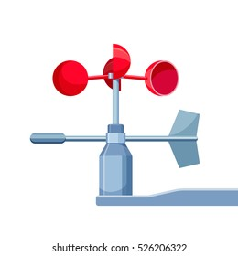

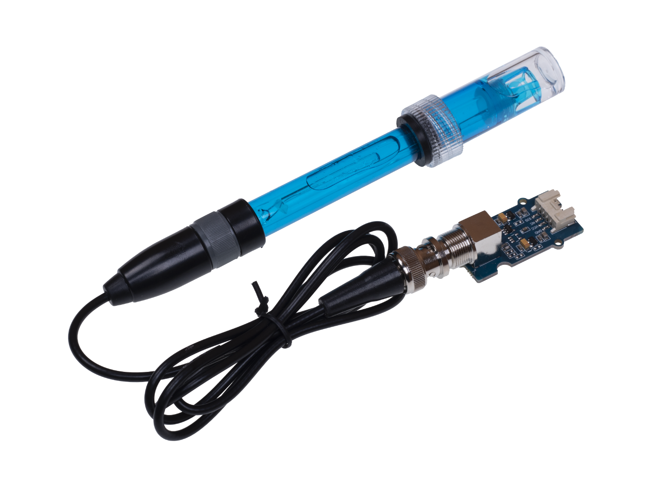
4. Agriculture Fields
Node - 1

Slide 19
Challenges Faced & How You Overcame Them
Challenge: PZEM energy module not reporting parameters
--Solution: Debugging Modbus/UART protocol as per the manufacturer’s user manual.
Challenge: Protocol diversity
--Solution: Solved using Home Assistant’s huge integration library + ESPHome custom configs.
Challenge: Privacy & Remote Access
--Solution: Avoided Cloud exposure by using Zerotier.
Challenge: Scalability
--Solution: Docker containers to keep services isolated & reliable.

Slide 20
Future Scope
Integration with renewable energy (On-grid, Solar, EV charging).
Support for industrial IoT use cases.
Integration with voice assistants for accessibility.
Expand to community/industrial scale: multiple Pis, server-based setup, dashboards for admins.
AI/ML for predictive alerts (e.g., motor failure, energy anomaly detection).

Slide 21
Conclusion
Our project is local-first, private, open source, vendor-agnostic.
Already field-tested (hall sensors for water tanks, DG set via Modbus).
More than a demo, it’s a working hub ready to scale beyond home to schools, hospitals, apartments, gateway communities and small-scale industrial setups.
Beats typical projects: not just a webpage on ESP, but a real smart home platform.
This project shows how open-source + Any SBC (Single Board Computer/old computers (e-waste devices) can make smart homes affordable, extensible, and sustainable.

Slide 22
Acknowledgements
To all the team members for their valuable time and inputs.
Youtube, Internet

